Slide 1
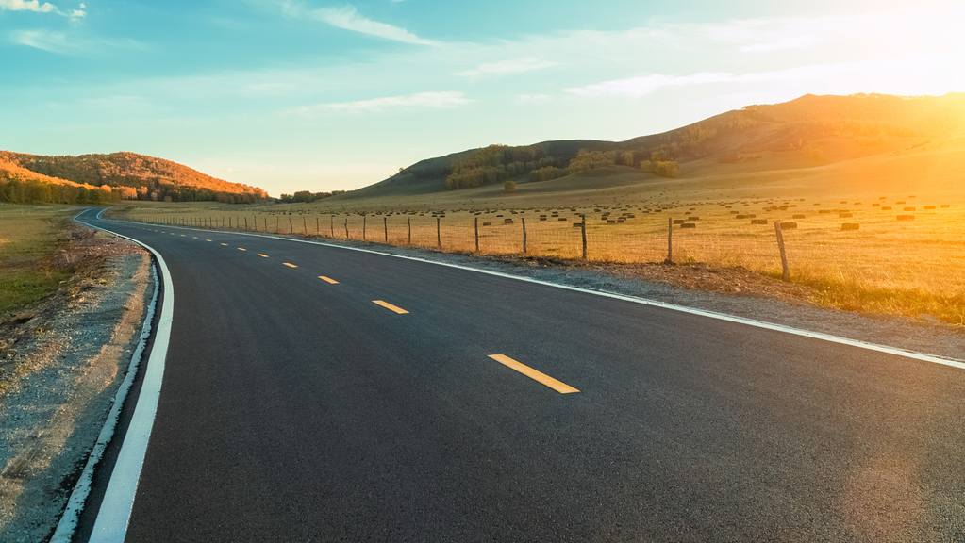

Lane and Vehicle Detection

Slide 2
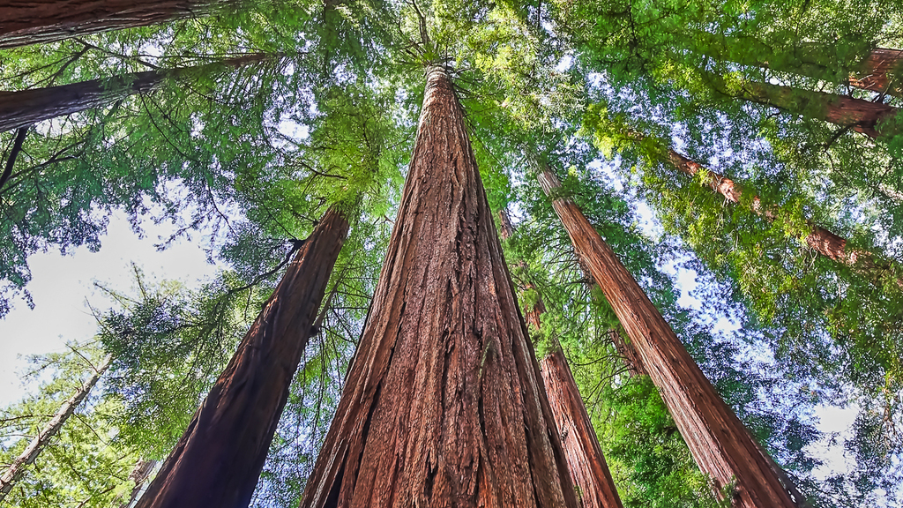
One
phase

Slide 3
Steps: 1. Camera Calibration
2. Wrapping (Change Perspective)
3. Threshold
4. Determine Left & Right lanes (Histogram)
5. Curve Fitting Of The Lane Lines
6. Radius of Curvature & Center Offset

Slide 4
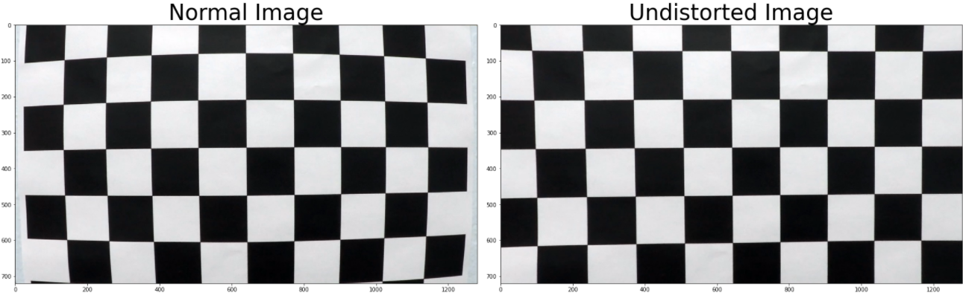
1. Camera Caliberation 📷
Every camera has some distortion factor in its lens.
It involves reading a set of chessboard images
Use cv2.findChessboardCorners() to identify the corners as img-points.
Run cv2.calibrateCamera() on object and image points to calculate the distortion coeffients
Execute cv2.undistort() with camera mtx to return the undistorted image

Slide 5
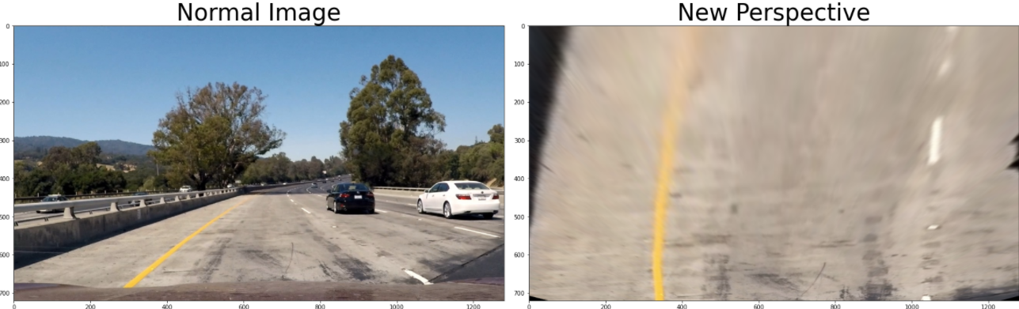
2. Wrapping
Isolate the lanes to focus on desired part of image
Adjusting our image to get a clear birds eye view 🐥
Map srcPoints to dstPoints
Run cv2.getPerspectiveTransform() to get the birds view

Slide 6
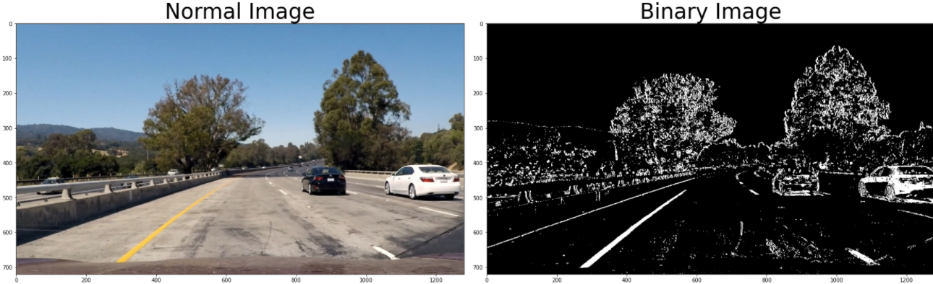
3. Threshold
HLS is more reliable than RGB
Use a combination of gradients using sobel operators as well as HSV transforms to create a binary image
Only color gradients above a certain threshold are colored white

Slide 7
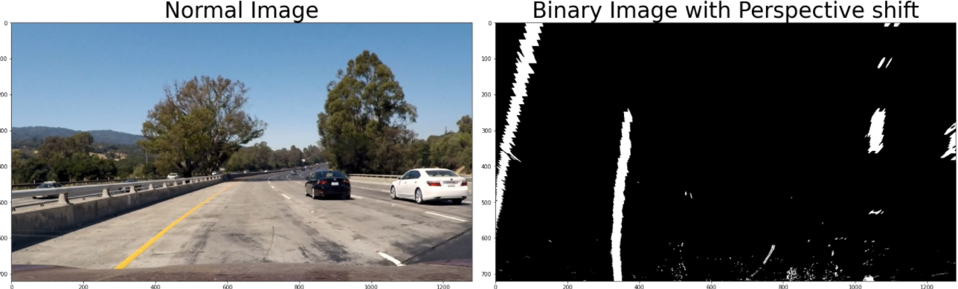
Putting Pieces together

Slide 8
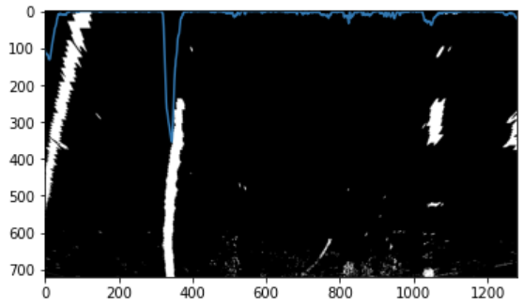
4. Determine the left and right lanes
Taking a histogram in the number of non-zero pixels along the horizontal axis
Notice the spikes of each lane in the histogram

Slide 9
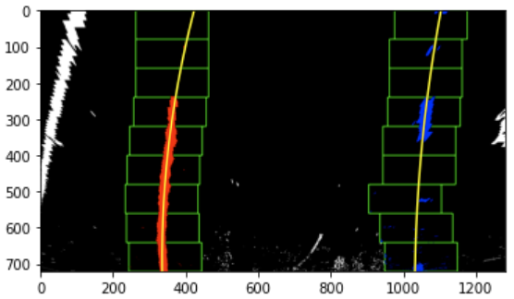
5. Polynomial curve fitting
Use polynomial to curve fitting the lane for better results
Run sliding window algorithm
Get window verticies
Draw rectangle
Identify non-zero pixels inside the window
Extract left and right lane pixels
Run np.poly to find polynomial for each
Draw lanes

Slide 10
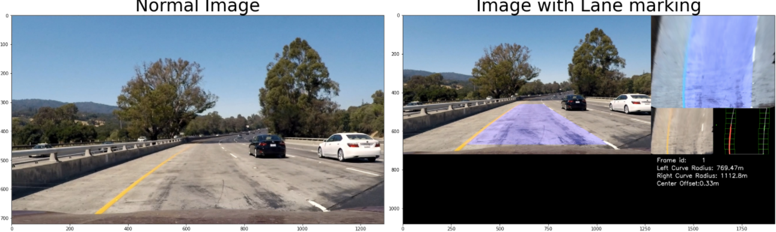
6. Radius of Curvature and Vehicle Offset
Function returns the radius of curvature of each lane
Convert from pixels to meters according to US lane dimensions
the center of the lane should be between the two lines detected
assume the camera is mounted at the center of the car, such that the center of the car is the midpoint
Calculate the offset by substracting ➖

Slide 11
Possible improvements: 🤔 1. Rain/Snow and weather conditions
2. Night-time 🕚

Slide 12
Two
phase

Slide 13
Steps:
1. Introduction
2. Detection at three scales
3. Neural Network Setup and Detect
4. Non-Maximum Suppression
5. Draw boxes

Slide 14
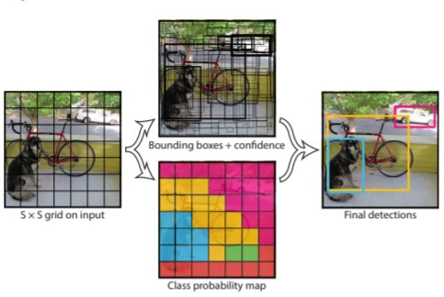
1. Introduction
Yolo object detection and recognition CNN for 80 objects 😲
Detections happens at 82, 94, 106
Several layers for detecting different dimensions/sizes of objects

Slide 15
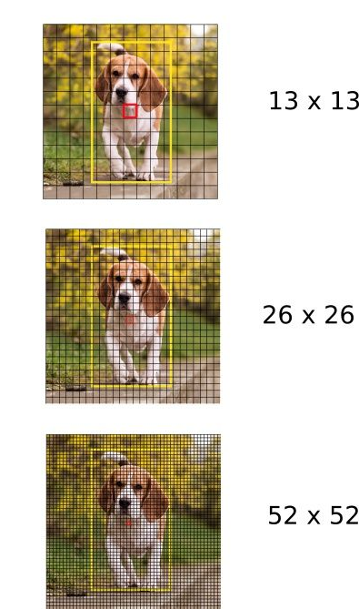
2. Detection
Input image is divisible by 32
Downsample into strides
Layer 82 for large objects (13x13)
Layer 94 for medium objects (26x26)
Layer 106 for small objects (52x52)

Slide 16
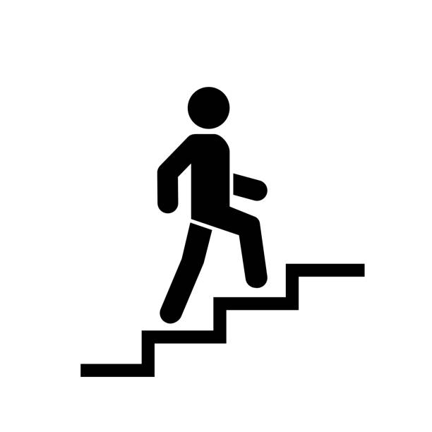
3. Setup and Detection steps
Run cv2.dnn.readFromDarkNet() with configs and weights
Run net.getLayers() to get the names of the layers
Run net.getUnconnectedOutLayer() to get the names of output layers
View coco.names to see all objects possible to detect
Pass image to cv2.dnn.blobFromImage() to create blob
Pass blob to net.setInput() to get the output of detection layers
Number of bounding box at each layer is 3
Predications whose confidence > threshold (0.85) are detected and thus we get their bounding boxes, predication and ids and append them to pre-defined array(s) 💾

Slide 17
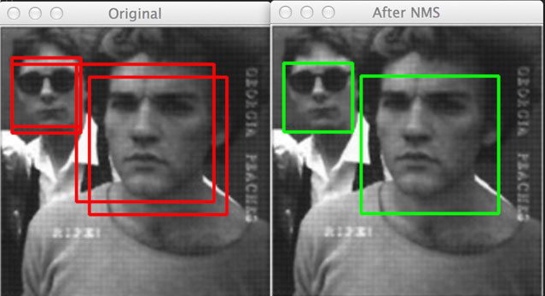
4. Non-Max-Suppression
Single object might have multiple bounding boxes 😱
Eliminate multiple boxes surrounding a single object by applying cv2.dnn.NMSBoxes()

Slide 18
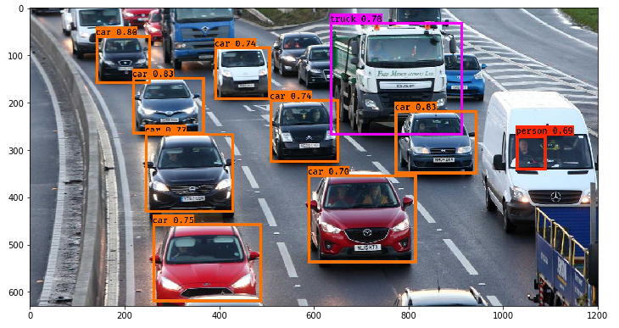
4. Final Image 👌
Loop over NMS result
Draw box with label and confidence

Slide 19
Ahmed Essam Hanaffi 1700127 Khaled Ahmed AbdelFatah 1700471 Mariam Fahmy Sobhey 1701404
Thanks 🎉

